Slide 1
Head Transplants
Marie-Claire Seare 4B

Slide 2
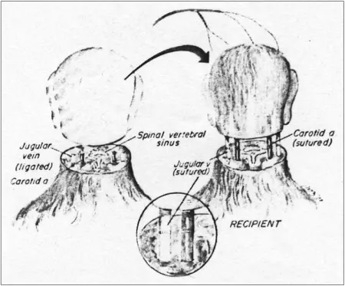
History
Who
When
Plan and Implantation
Pros
Cons
Summary
Sources
O V E R V I E W

Slide 3
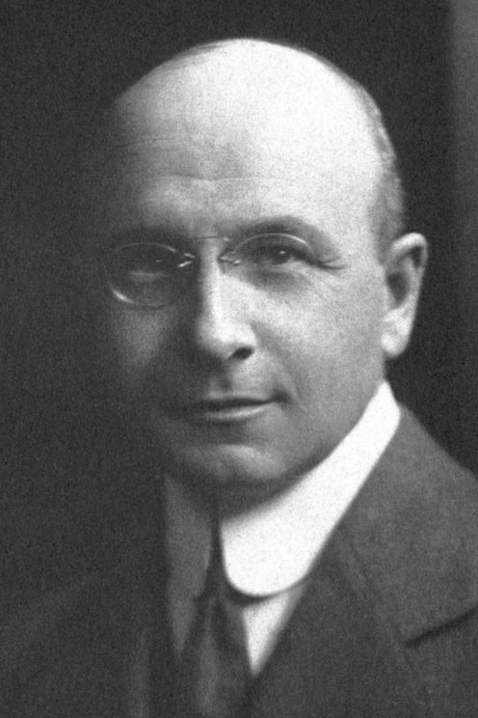
History
Who:
The challenge faced by vascular surgeons was how to cut and repair an injured vessel and subsequently restore blood flow without interrupting circulation
Italian scientist Sergio Canavero and Chinese surgeon Xiaoping Ren are developing a plan to transplant a human head — right down to neck bolts and electricity.
Their focus is to help patients with spinal cord injuries and paralysis.
French surgeon, Dr. Alexis Carrel,
Notes:
It was French surgeon, Dr. Alexis Carrel, who changed these results by using a more reliable method of suturing severed vessels back together: he used fine needles and extremely thin threads as suture and enlarged the severed vessel opening using three retaining sutures to form a triangular shape.
The surgeons have already performed the procedure on mice, rats and a dog, all of which survived the surgery and even regained some motor function.
Although the scientific and medical advancements necessary for human head transplantation are rapidly approaching plausibility, major ethical and moral hurdles remain.

Slide 4
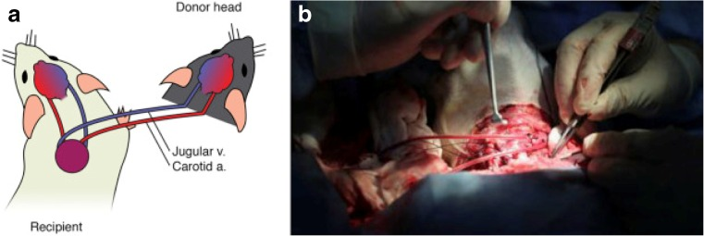
History
When:
Ever since the early 1900s, people have discussed the possibility of head transplantation. However, transplantation surgery at that time faced many challenges.
In 1908, Carrel and American physiologist, Dr. Charles Guthrie, performed the first dog head transplantation.
Notes:
In 1965, Robert White, an American neurosurgeon, also attempted head transplantation.In 1970, White performed the first cephalic exchange transplantation in primates. He performed four cephalometric associations between isolated monkey heads and isolated monkey bodies, employing direct suture of the carotid and jugular veins.

Slide 5
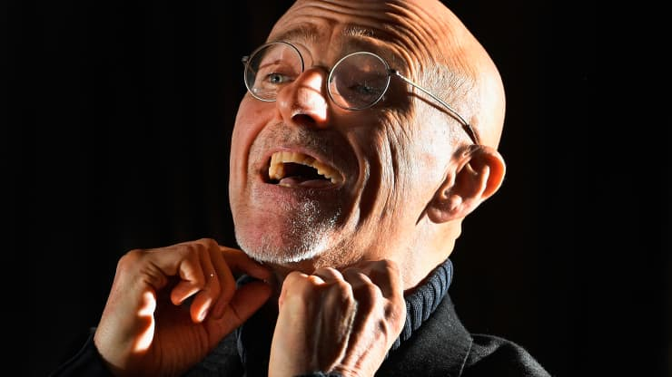

Plan:
Canavero has been talking up his plan for human head transplantation in TED talks and the media for decades, despite producing little in the way of scientific evidence,
Notes:
An adhesive called polyethylene glycol will be used to connect the volunteer’s head with the spinal cord of the donor’s body. The plan is to induce the volunteer into a coma for a month while blood and new nerve networks rebuild in hopes that the body doesn’t reject the head — an inherent type of risk in all transplant procedures. In addition to the spine, the head will also have to be reconnected to airways, the esophagus and blood vessels.
announce in 2015 that he would perform surgery on a human volunteer — a young man with Werdnig-Hoffman disease, a degenerative disease where the muscles waste away — by 2017.

Slide 6
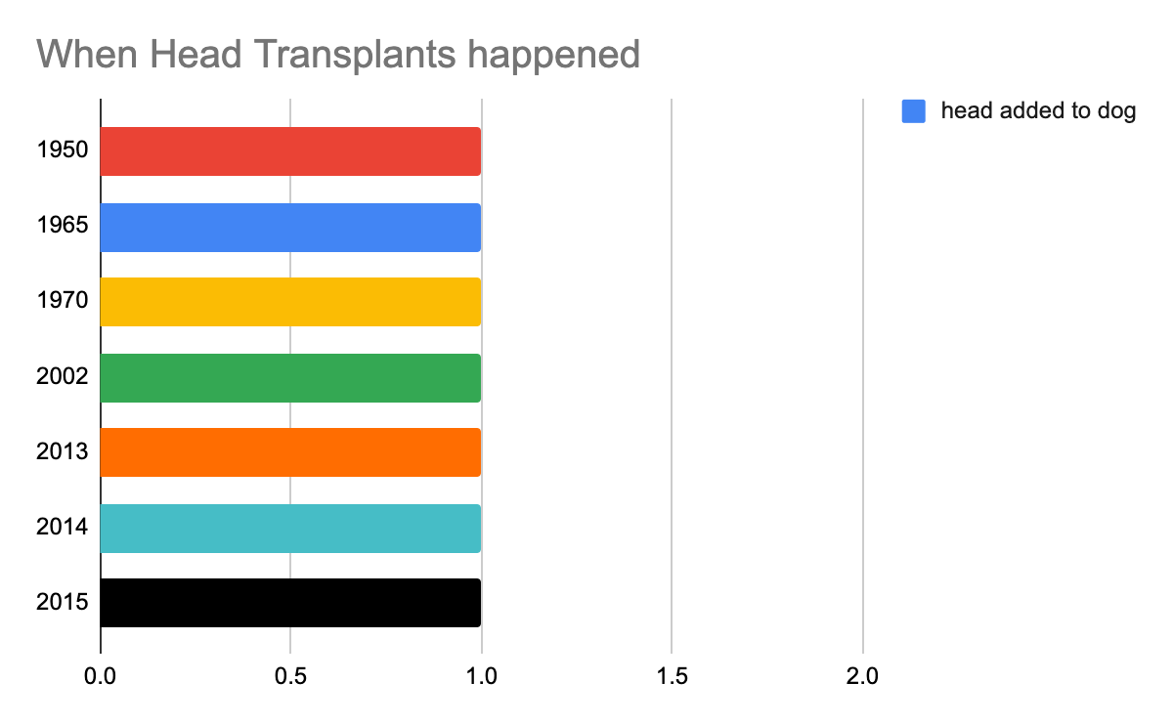
Implementation:
Many of the headlines say so. “No, Human Head Transplants Will Not Be Possible by 2017,” said Popular Science. The International Business Times pronounced head transplants “not a thing.”
“The first human transplant on human cadavers has been done. A full head swap between brain-dead organ donors is the next stage,” Canavero said at a press conference in Vienna, the Telegraph of the UK reported.
Notes:
This has not happened yet on a living person.

Slide 7
PROS
And what would we make of it if someone did go there? It might well be impossible to deliver what the public might expect: a person who walks around perfectly normal except for their mismatched body. But what if a head-transplant patient—say someone who was dying of an incurable disease, or a quadriplegic with failing organs—were to live several years attached to a paralyzed body? Is that a success?
To the advancement

Slide 8
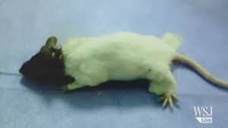
CONS
If he does actually try to go through with it, suddenly head transplants will be a thing. And even if the plan fizzles, we might want to figure out whether we even want to go there, before someone does.
To the advancement

Slide 9
Summary
I think that this is a very interesting innovative science. I do not know which side I stand on for if this is ethical or not. I can see both sides. On one side this is a large step in neuroscience and would be a miracle for people who have conditions that cannot be helped. On the other hand we do not know how many subjects they will need for testing.

Slide 10
Resources
The history of head transplantation: a review by National Library of Medicine
Two surgeons in China developing a method to transplant a human head by CNBC
Human Head Transplant Proposed—How Did We Get Here? By National Geographic
World’s first human head transplant a success, professor says by NY Post

